Slide 1
3.4 Web Design Portfolio
(pablo paulsen)

Slide 2
Step 1 : Empathize

Slide 3
Task 1 : Identify your client and the purpose of your website, who is your target audience?
My client is George Furst. A professor that I know from Korea that enjoys to hike and canoe.
A quote from the client “My ideal is to have a website that would come up if a foreigner googles mountains of Korea or something similar. I also plan, as I said yesterday, to do a similar project on canoeing the rivers of Korea. They are a wonderful resource for recreation that is terribly underutilized.”
The purpose of the website is therefore to help people, especially foreigners living in Korea to find out more about Korean mountains and rivers.
It was also mentioned that in the future he wants to write a book about his experiences of hiking and canoeing in Korea. Therefore will also have some information about him
He is part of a group of foreigner hiking group and would also like to promote this group on his site

Slide 4
Relevant Implications - Aesthetics
Navbar should sit a the top of the page and the links should sit either on the left/right-hand side of the logo or menu
Have a clear contrast of front e.g white background with black font
Keep the design minimal, use white space to ensure the design is not cluttered
Rule of thirds - the top third should contain the nave bar and dominant image, the main section should be your content and the last sections should contain a footer with copyright info and links.
The font should be scalable so that I easy to read across devices.
Notes:
Identify and explain 3 relevant implications that you will focus on during the creation of your project

Slide 5
Relevant Implications - Accessibility
Make sure your page can scale across multiple devices e.g tablet, PC and phone using media queries
Use alt tags on image for blind people
Meta tags in the head section, give a decent description so the search engines your site
Hyperlinks should be obvious, have hover effects of some kind and should work
Notes:
Identify and explain 3 relevant implications that you will focus on during the creation of your project

Slide 6
Relevant Implications - Future Proofing and sustainability
Code comments to help future coders understand your code
Use DIV tag rather than HTML5 tags to ensure a consistent and accurate design
CSS3 is the most up to date style sheet
Avoid using plugins
In the footer, note the year the site was created and by whom so users know it is up to and can contact you
Keep updating content to ensure that your information is correct
Notes:
Identify and explain 3 relevant implications that you will focus on during the creation of your project

Slide 7
What are your client’s specifications?
Home page with general information and about me section
Hiking page with each mountain getting its own sub-page
Canoeing page with each river getting its own sub-page
A page with information about his hiking group
Responsive design for desktop and mobile
Use of the provided photos

Slide 8
Step 2 : Define

Slide 9
Website Structure
index.html
hikes.html
canoeing.html
deajeonhikers.html
(1 page for each mountian).html
(1 page for each river).html

Slide 10
Evidence of written permission

Slide 11
Data Integrity Gather content – proofread and edit
Notes:
Data integrity is ensuring the information displayed is up to date , spelled correctly . Do F7 on your word content.
Testing

Slide 12
Gather Content
Notes:
Save images to an appropriate name folder
Compress / edit images where need be
Name the files accurately e.g home_mainimage.jpeg suzanne_collins_closeup.jpeg rather than 249784sflkjfnjksfxn3r8.jpeg
Record this process

Slide 13
photos
All of my photos for index and Daejeon hikers page will go straight in to my images folder. However in order to not have 1000s of unorganized photos each page about each mountain and river will get its own folder.
In order to load the page as fast as possible I used googles https://squoosh.app/editor web image compressor as it uses good compression algorithms designed for websites allowing me to get smaller file size for a quality image. For parallax image I made the image width to 1920px as this is the width of the commonly used higher resolution monitor using resize method Catmull-rom. I used mozJPEG with 60% quality as this is the lowest I could go without artefacts showing up in images. This allows for file size generally below 250kb. For regular image I set the size to max width and max height to be 1280px with quality of 70% in order to avoid artefacts that make the image harder to read.

Slide 14
Step 3 : Ideate

Slide 15
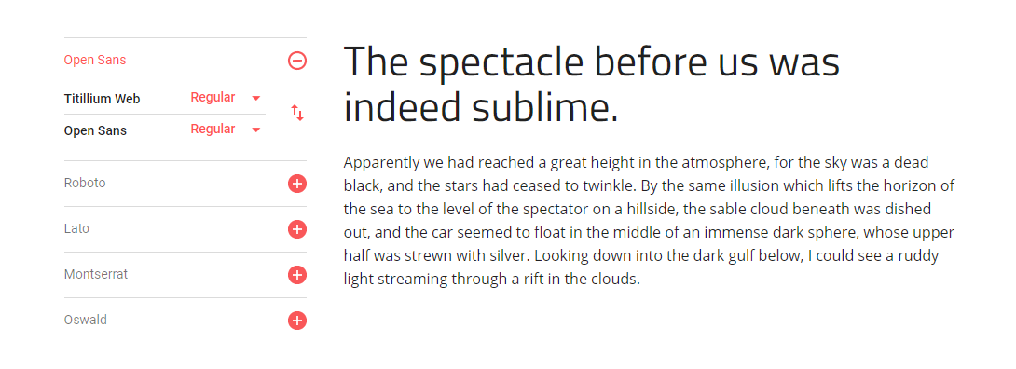
Font Combinations
I choose to use titillium web for nav bar links and heading while using open sans for regular text

Slide 16
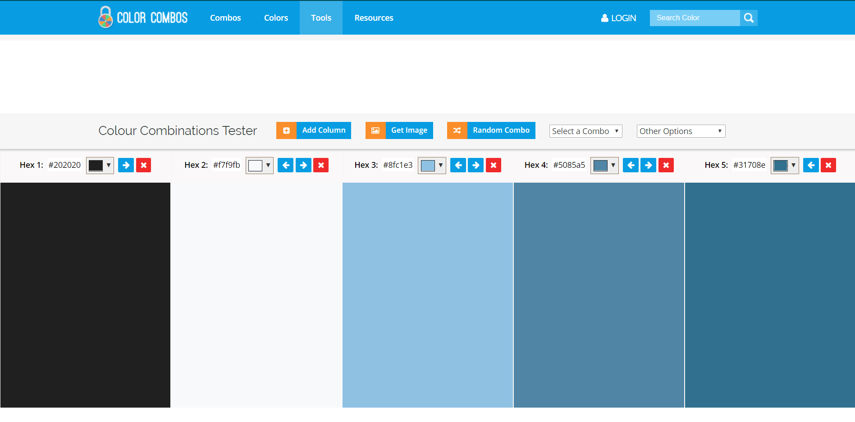
Color combo
As the site I am making is a nature based site with info about rivers and mountain I based my colour combo on an image of a lake and added a not fully black in order to be softer and a slightly of white with 3 different shades of blue

Slide 17
Low fidelity wireframes 1
The images are too big and covering most of your page. I like the parallax. Your footer is too big for your lack of content.
Banner image as well as the navbar look nice and would be easy to scale for mobile. Parallax images look nice but some of the images are too big. Footer has quite a lot of empty space, could use some extra content. Could in some cases combine parallax effect with the h1 tag to reduce very large page height.
David – Nice use of white space and divs on multiple parallax images. Links on nav links seem really far away from links. Footer seems very asymmetric.
Notes:
Use either

Slide 18
Low fidelity wireframes 2
David - Lots of content. Imagery covers most of the page. Nav bar appears really pushed in.
Jack – Navbar doesn’t work well being centered. Also image looks really stretched. Lots of images that seem random. Lots of dead space in footer. Image slider that is not on other page is a good idea
Notes:
Use either

Slide 19
A vs B testing
Notes:
Give two layout options for the index page – eg placement of cotent . Get feedback from client

Slide 20
Response to feedback
Overall design 1 has much better feedback especially around the nav bar therefore for I will keep design 1 with some updates to the feedback
I received feedback saying that my images were too large. So I reduced the size of some of the images where possible
I also received feedback saying that footer was too big. So I reduced the height of the footer in order to reduce white space
I also reduced the spacing between the links a little bit
I also am considering adding the image slider that received positive feedback to replace the top parallax image on design 1 or add it to another page where more images could be required

Slide 21
High Fidelity Mock-ups
Snip and place it here
Notes:
Create a visual mock up of your index page using adobe xd or publisher

Slide 22
Feedback from client / stakeholders
Notes:
Get written feedback, then add your own reflections:
What changes do you need to make and why? Do you need to carry out further research or give more colour/font options etc/

Slide 23
Step 4 : Protype/ Testing

Slide 24
Site setup

Slide 25
Evidence of iterative improvement

Slide 26
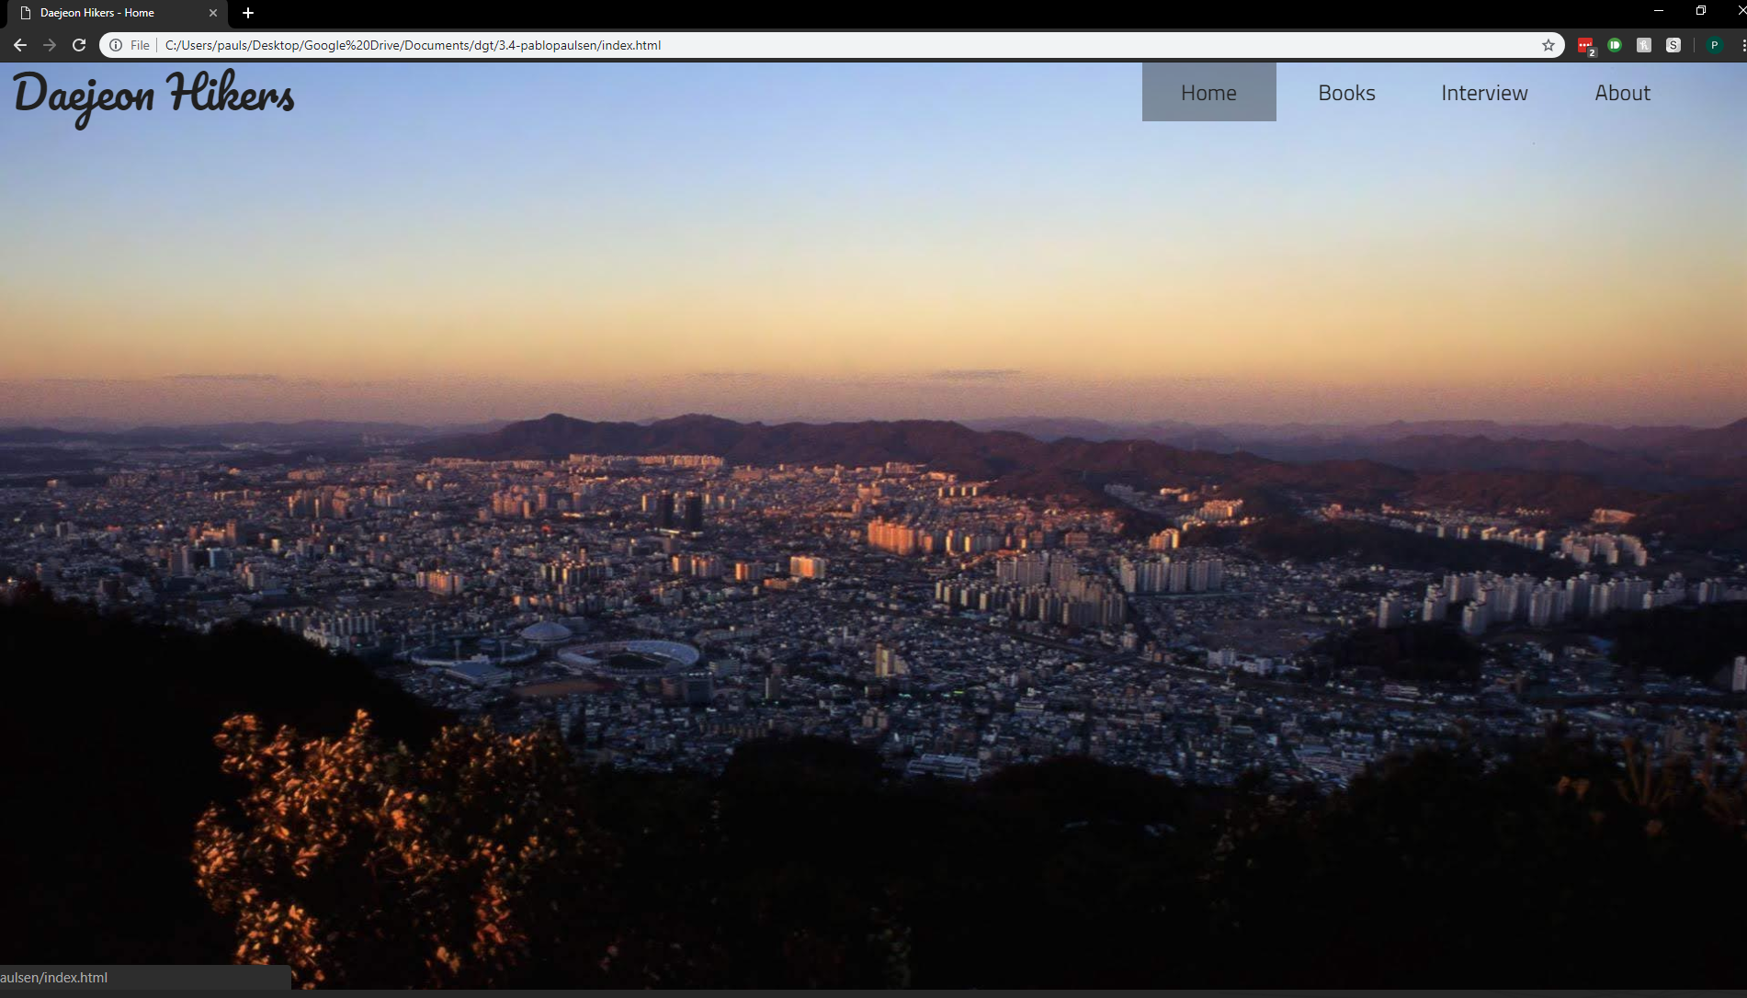

Slide 27
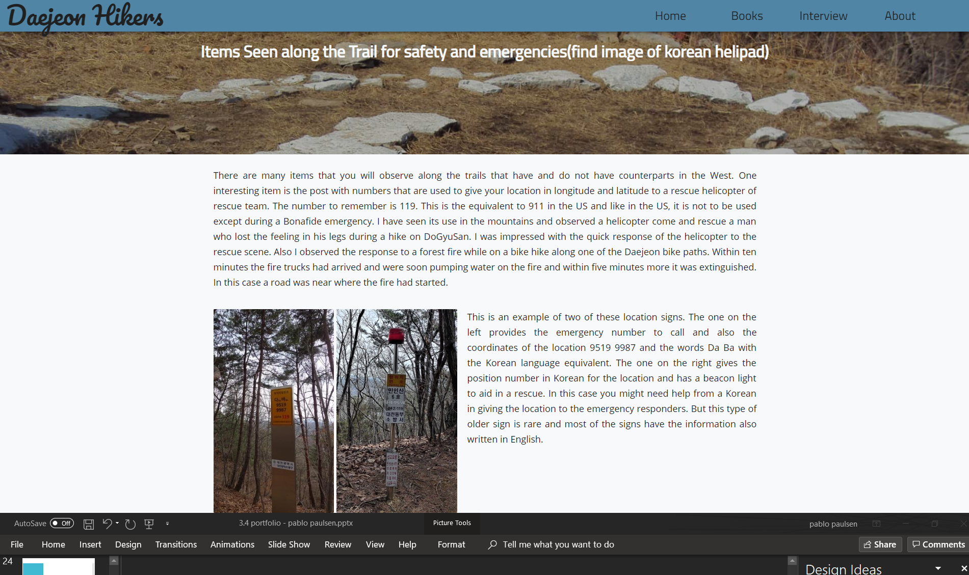

Slide 28
Feedback
Jack Olsen: Navbar has good font choice, however I would change the hover effect. The grey block behind it doesn’t look good with the image. A lot of empty space in some of the paragraphs with images. In mobile view it would be nice if you had a sticky nav, as the top nav disappears and to go to a new page after scrolling to the bottom you would have to scroll all the way up. Maybe you could have a scroll to top as the page content is very high.
Notes:
Give two different options for font / colours – save the different versions
Screenshot them and get votes for stakeholders

Slide 29
Feedback
**Zac**
I am concerned with the white space
I Like the parallax effects and hover effects.
Maybe have a h2 or h3 heading as the top with space below to reduce your whitespace.
Notes:
Give two different options for font / colours – save the different versions
Screenshot them and get votes for stakeholders

Slide 30
Response to feedback
I changed the hover effect of nav bar so that when the parallax image is visible there is no change in the background colour of the nav and text colour of the link changes
I also change the mobile navbar so that its position is fixed

Slide 31
A vs B testing
Feedback
I prefer the top footer. The copyright statement under the links with the lighter grey text is well done. Compared to the black copyright statement under the Facebook link. The white text on dark background is very professional looking. The facebook logo could have a white f maybe.
I also prefer the top footer. The text colour of the bottom footer seems a bit too dark. The gap between the dark mode icon and the facebook icon is quite large. You should add another icon with the facebook logo, because one just seems a bit lonely
Notes:
Give two different options for font / colours – save the different versions
Screenshot them and get votes for stakeholders

Slide 32
Testing Scaling: Phone vs Desktop
Notes:
Test your site on mobile, tablet and pc view

Slide 33
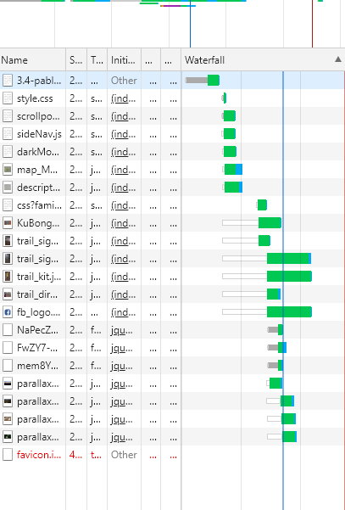
Testing Procedures: performance
I hosted my website using git hub in order to check the loading speed and any files that may take longer to load. As all of my files are compressed Loading time was short and only 1.9mb was downloaded which means even with a 5mbps internet connection the site should only take 4 seconds to load
Notes:
Validate your HTML/CSS3 website – screenshot the no errors.

Slide 34
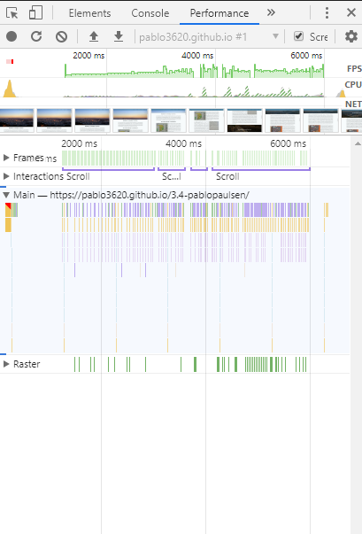
Testing Procedures: performance
I then check performance and noticed some frame dropping and computer fan spinning up. I then used chrome developer tools and found that my scroll function was taking very long to change the style. After some testing I realized that my parallax image blurring as you scroll was causing the performance issues so I disabled it.
Notes:
Validate your HTML/CSS3 website – screenshot the no errors.

Slide 36
Applying the usability heuristics to improve your design
Notes:
Identify which usability principles you have applied to improve the quality of your design – screenshot your design, place in your portfolio and annotate and explain how it improved the usability, aesthetics or functionality etc.

Slide 37
Explain how your final design addressed the relevant implications

Slide 38
Addressing relevant implication :

Slide 39
Addressing relevant implication :

Slide 40
Final website
Notes:
Create a video of your site in desktop view, slowly going through the content, scale it down to phone view too,. Insert the video above

Slide 41
Final feedback from client

